Slide 1
Request 1
Agree with condition (what must happen first)
express willingness (nod)
give condition (raise head and brows, shift to side)
tell what you will do (“when” clause, nod)
check if person agrees (raise brows, lean head forward, hold sign)
Notes:
8:4, page 181.

Slide 2
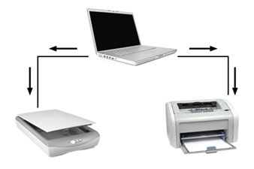
Request 2
Agree with condition (what must happen first)
express willingness (nod)
give condition (raise head and brows, shift to side)
tell what you will do (“when” clause, nod)
check if person agrees (raise brows, lean head forward, hold sign)
Notes:
8:4, page 183.

Slide 3
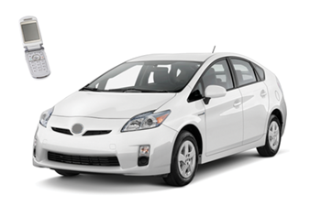
Request 3
Agree with condition (what must happen first)
express willingness (nod)
give condition (raise head and brows, shift to side)
tell what you will do (“when” clause, nod)
check if person agrees (raise brows, lean head forward, hold sign)
Notes:
8:4, page 184.

Slide 4
Pair Practice
Request 1
Request 2
Request 3
A: explain situation, make request
B: agree with condition (explain what must happen first)
express willingness (nod)
give condition (raise head and brows, shift to side)
tell what you will do (“when” clause, nod)
check if person agrees (raise brows, lean head forward, hold sign)
Notes:
8:4, page 185.

Slide 5
Request 4
Agree with condition (what is expected)
express willingness (nod)
give condition (raise head and brows, shift to side)
tell what is expected (“when” clause, nod)
check if person agrees (raise brows, lean head forward, hold sign)
Notes:
8:4, page 185.

Slide 6
Request 5
Agree with condition (what is expected)
express willingness (nod)
give condition (raise head and brows, shift to side)
tell what is expected (“when” clause, nod)
check if person agrees (raise brows, lean head forward, hold sign)
Notes:
8:4, page 187.

Slide 7
Request 6
Agree with condition (what is expected)
express willingness (nod)
give condition (raise head and brows, shift to side)
tell what is expected (“when” clause, nod)
check if person agrees (raise brows, lean head forward, hold sign)
Notes:
8:4, page 188.

Slide 8
Pair Practice
Request 4
Request 5
Request 6
Agree with condition (what is expected)
express willingness (nod)
give condition (raise head and brows, shift to side)
tell what is expected (“when” clause, nod)
check if person agrees (raise brows, lean head forward, hold sign)
Notes:
8:4, page 188.

Slide 9
A: explain situation, make request
B: agree with condition (what is expected)
express willingness (nod)
give condition (raise head and brows, shift to side)
tell what is expected (“when” clause, nod)
check if person agrees (raise brows, lean head forward, hold sign)
Notes:
8:4, page 189.

Slide 10
A: explain situation, make request
B: agree with condition (what must happen first)
express willingness (nod)
give condition (raise head and brows, shift to side)
tell what you will do (“when” clause, nod)
check if person agrees (raise brows, lean head forward, hold sign)
Notes:
8:4, page 190.

Slide 11
A: explain situation, make request
B: agree with condition
what must happen first or
what is expected
Notes:
8:4, page 191.

