Slide 1
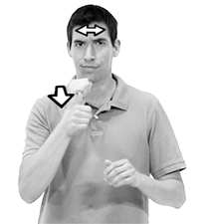
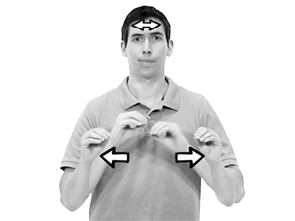
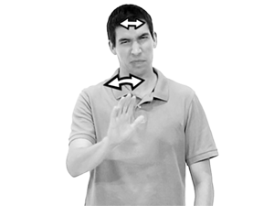
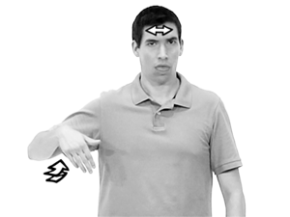
1.
Definition: used to express negation, denial, or refusal
2.
Definition: to lack something; not present or doesn’t exist.
3.
Definition: (gesture) to warn or advise against doing something
4.
Definition: not yet completed or accomplished
Notes:
8:5, page 195.

Slide 2
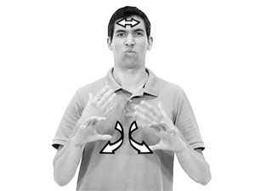
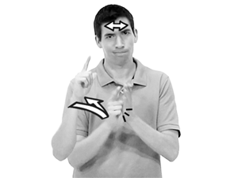
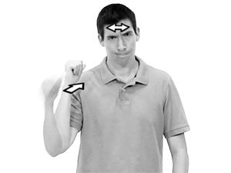
5.
Definition: to have no desire to;
to have no interest in doing something
6.
Definition: to prohibit; to forbid; to not allow
7.
Definition: to refuse; not willing to
Notes:
8:5, page 196.

Slide 3
I don’t have your phone number.
My nephew won’t eat peas.
Translating negative sentences
establish time if specified (raise brows)
establish location if specified (raise brows)
name the topic (raise brows)
end with a negation (shake head)
Be mindful there may be exceptions.
Notes:
8:5, page 197.

Slide 4
There is no class Thursday.
Don’t chew your nails.
Translating negative sentences
establish time if specified (raise brows)
establish location if specified (raise brows)
name the topic (raise brows)
end with a negation (shake head)
Be mindful there may be exceptions.
Notes:
8:5, page 198.

Slide 5
You can’t smoke in restaurants.
I haven’t met your mother.
Translating negative sentences
establish time if specified (raise brows)
establish location if specified (raise brows)
name the topic (raise brows)
end with a negation (shake head)
Be mindful there may be exceptions.
Notes:
8:5, page 199.

Slide 6
Don’t forget to bring your book.
I don’t want Jack to come.
Translating negative sentences
establish time if specified (raise brows)
establish location if specified (raise brows)
name the topic (raise brows)
end with a negation (shake head)
Be mindful there may be exceptions.
Notes:
8:5, page 200.

Slide 7
I didn’t finish my homework.
These cookies are sugar free.
Translating negative sentences
establish time if specified (raise brows)
establish location if specified (raise brows)
name the topic (raise brows)
end with a negation (shake head)
Be mindful there may be exceptions.
Notes:
8:5, page 201.

Slide 8
You don’t have to pay me back.
You should not read her mail.
Translating negative sentences
establish time if specified (raise brows)
establish location if specified (raise brows)
name the topic (raise brows)
end with a negation (shake head)
Be mindful there may be exceptions.
Notes:
8:5, page 202.

