Slide 1
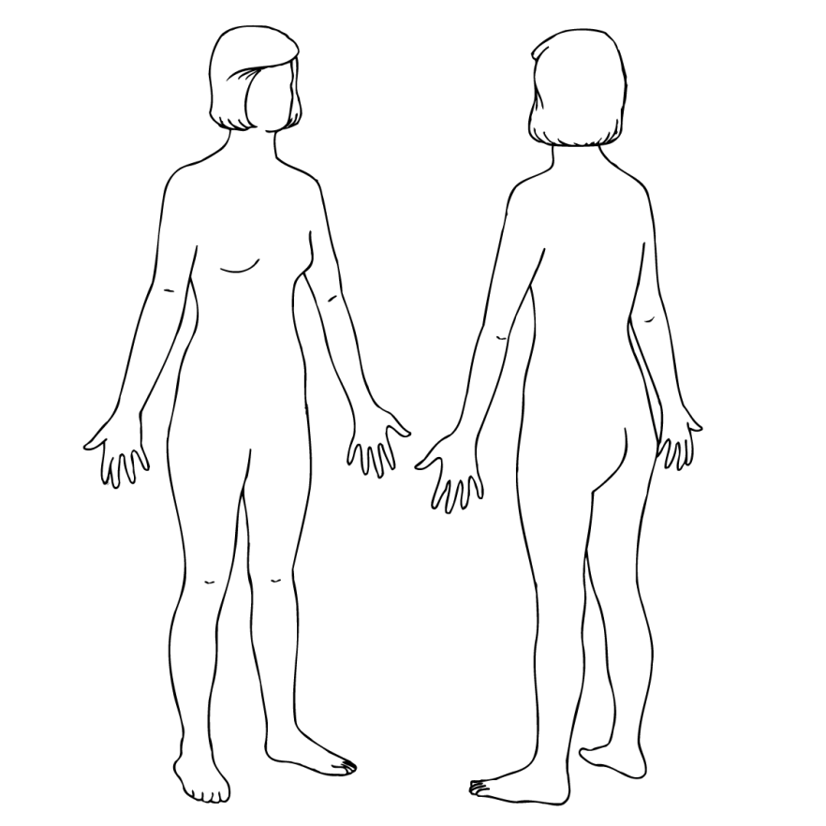
The Human Body
Notes:
M41
p.216

Slide 2
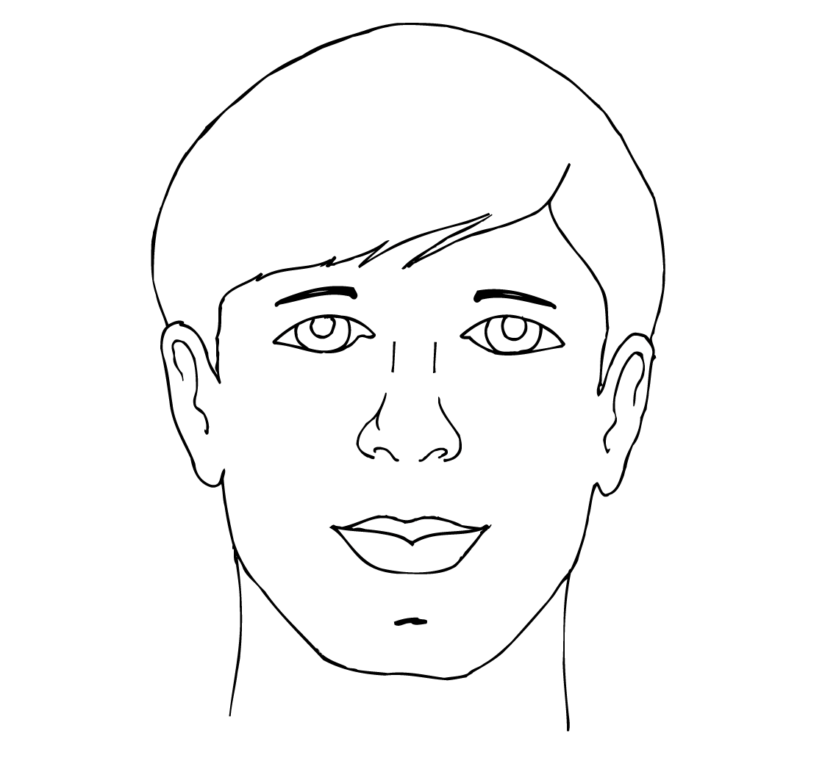
The Face
Notes:
M42
p.217

Slide 3
noun (name of)
description
• shape
• behavior
• function
Notes:
B39
p.218

Slide 4
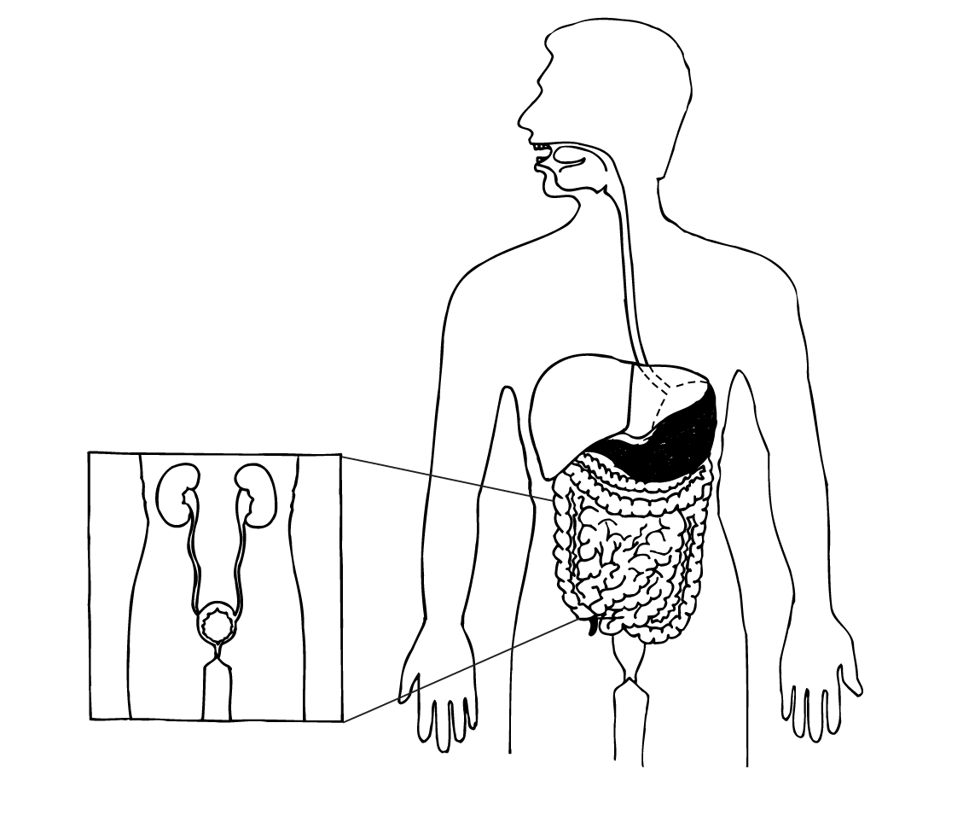
The Digestive System
Notes:
M43
p.219

Slide 5
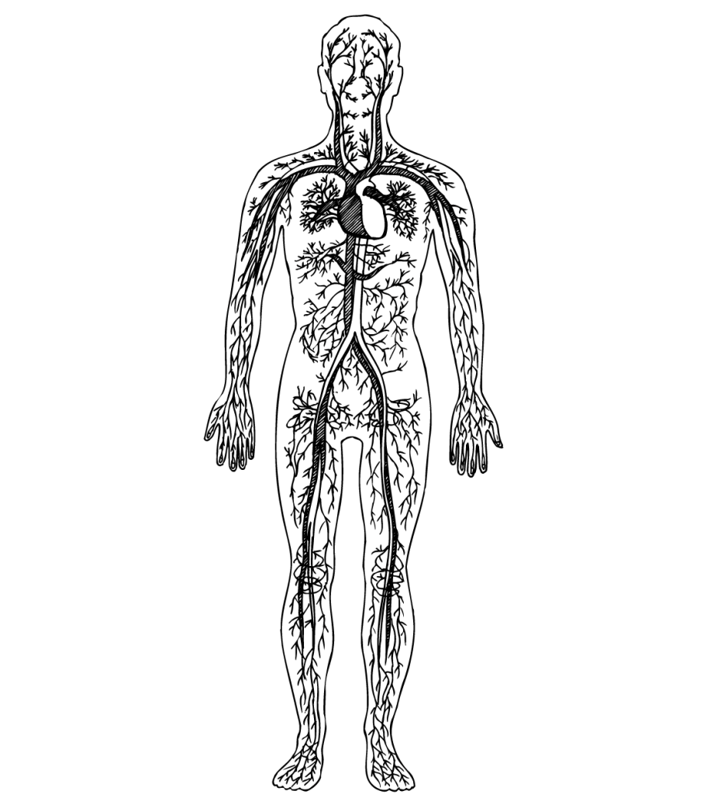
The Circulatory System
Notes:
M44
p.220

Slide 6
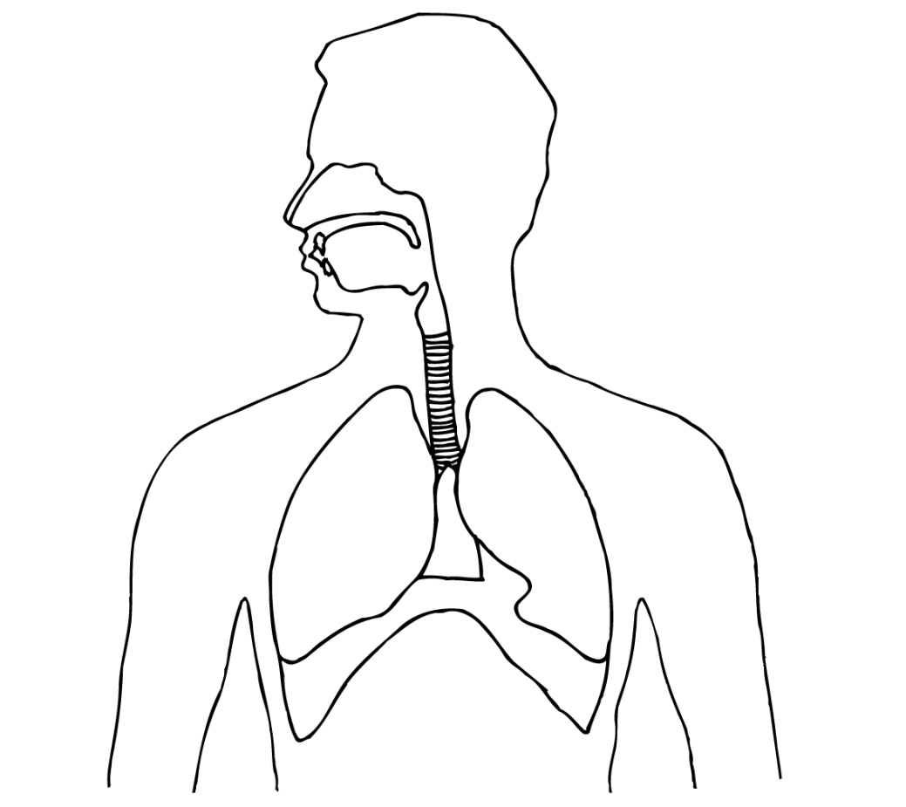
The Respiratory System
Notes:
M45
p.221

Slide 7
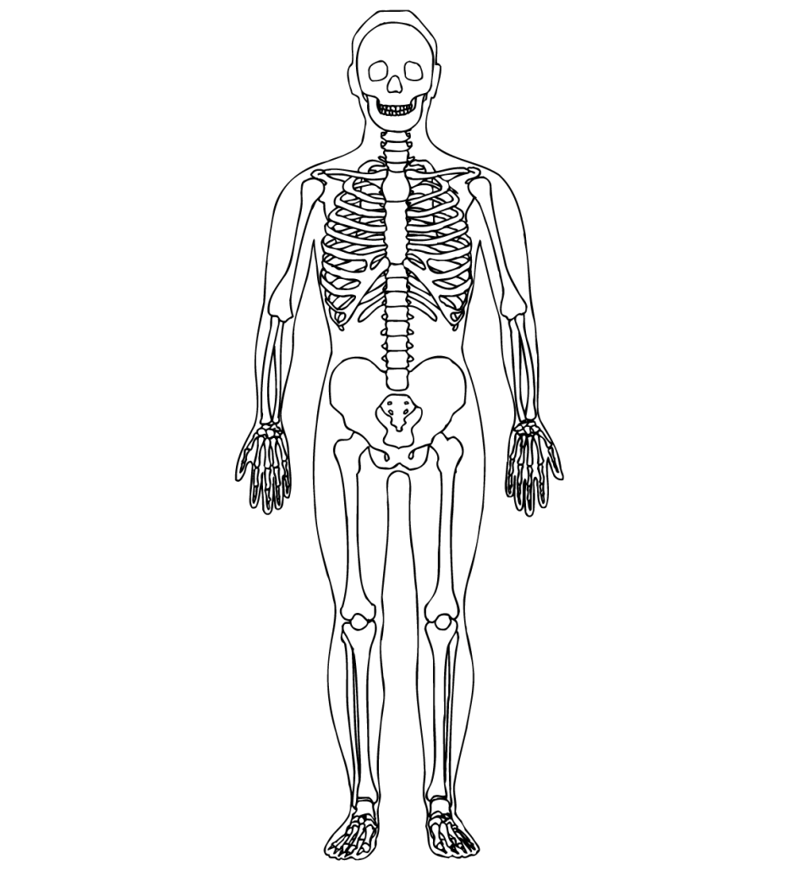
The Skeletal System
Notes:
M46
p.222

Slide 8
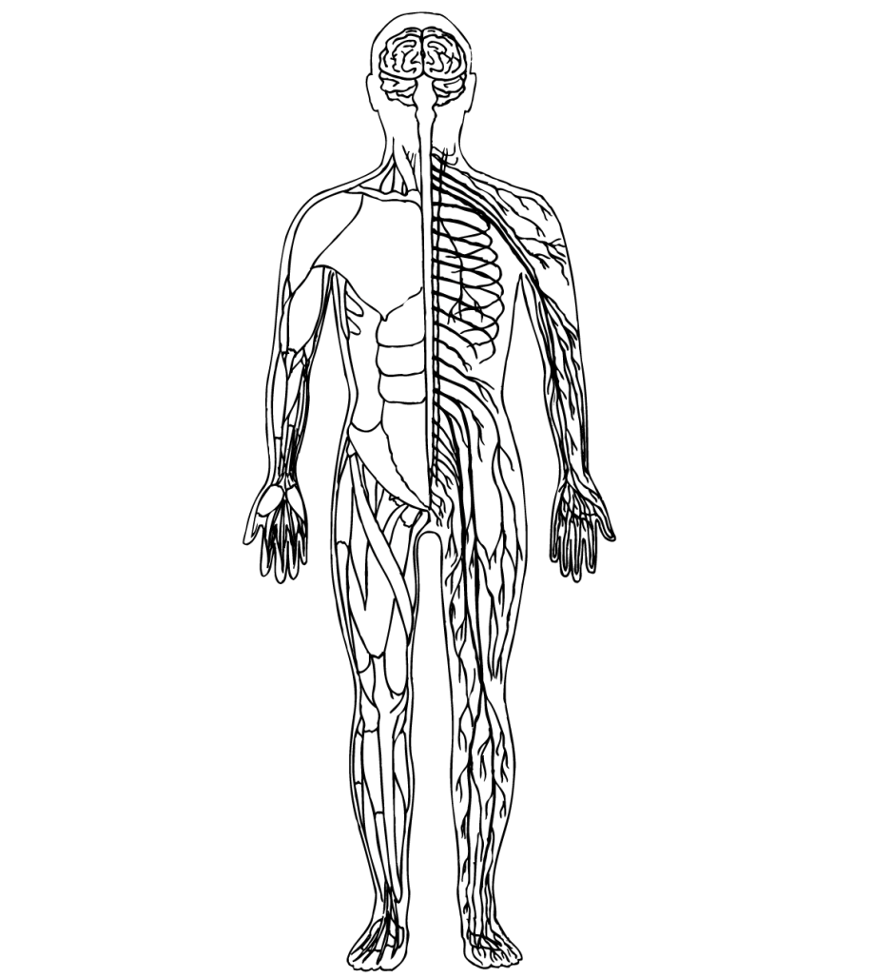
The Muscular/Nervous System
Notes:
M47
p.223

Slide 9
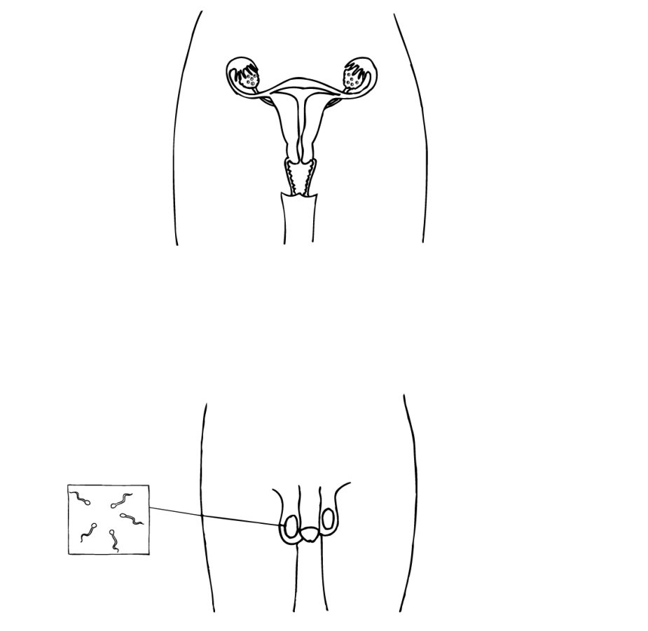
The Reproductive System
Notes:
M48
p.224

Slide 10
Discuss a condition
describe symptoms
Conditions
hay fever
arthritis
hepatitis A migraine
anemia
shingles
athlete’s foot
Notes:
B40
p.235

Slide 11
Discuss a condition
describe symptoms
describe causes
Conditions
hay fever
arthritis
hepatitis A migraine
anemia
shingles
athlete’s foot
Notes:
B41
p.236

Slide 12
Discuss a condition
describe symptoms
describe causes
discuss treatment
Conditions
hay fever
arthritis
hepatitis A migraine
anemia
shingles
athlete’s foot
Notes:
B42
p.239

Slide 13
Treatment Vocabulary
apply
– pressure
– ointment
– powder
take
– vitamins or pills
– a shower
– weight off
use
– nasal spray
– a cane
– topical cream
– compress
get
– injection or vaccination
– prescription
– rid of dust, mold, mildew
to rid body of toxins
Notes:
M76
p.239

Slide 14
avoid
– drinking certain liquids such as coffee and alcohol
– pets
– red meat
– uncooked food
– food preservatives
– processed meats
– MSG
massage (“areas”)
– temples
– (reflexology points)
Soak (parts of body) in water
– foot
– hand
– body
Notes:
M77
p.239

Slide 15
Treatment Phrases
change behavior
– change eating habits
– cut down on
– reduce weight, stress, pressure
– lose weight
– practice safe sex
– do not eat…
– eat a diet high in…
– fasting
physician’s duties
– blood transfusion may be required
– surgery may be performed
– getting an injection
– medication can be prescribed
– hypnotic suggestion
Notes:
M78
p.241

Slide 16
purposes/goals
– to prevent the development of nerve pain
– to prevent infection
– to provide relief from nerve pain
– to control severe symptoms
– to increase tolerance to certain allergens
– to increase flexibility
– to increase mobility
– to increase iron intake
– to protect the joints
– help the patient relax
– to fight the virus
– to reduce sharp pain
– to reduce the burning sensation
– to relieve symptoms
– to relieve stress by promoting relaxation
Notes:
M79
p.241

Slide 17
Medication
aspirin
painkiller
Guidelines
If the medication is common—spell it out, tell how it is taken and its purpose
If the medication is uncommon—don’t spell it out, tell how it is taken and its purpose
Notes:
B43
p.243

Slide 18
Medication
painkiller
aspirin
anti-viral drugs
corticosteroids
topical cream (capsaicin)
vitamin B complex
arsenicum and mezereum
Guidelines
If the medication is common—spell it out, tell how it is taken and its purpose
If the medication is uncommon—don’t spell it out, tell how it is taken and its purpose
Notes:
B44
p.244

Slide 19
Discuss a condition
describe symptoms
describe causes
discuss treatment
tell if it is curable
list treatment options on weak hand
Conditions
hay fever
arthritis
hepatitis A migraine
anemia
shingles
athlete’s foot
Notes:
B45
p.245

Slide 20
Dialogue Practice
Situation:
A:
B and C:
A:
B and C:
A:
B and C:
A:
B and C:
“A” suspects s/he has a specific kind of health condition and goes to seek the advice of two health-care experts.
explain symptoms
identify possible condition
ask what might be the cause(s)
describe possible / known causes
ask what s/he should do now
suggest different treatments
ask questions about treatments to clarify
explain
Notes:
M80
p.249

Slide 21
name condition, briefly describe symptoms (use topicalization)
describe causes (use rhetorical question)
discuss treatment options (use rhetorical question)
Notes:
B46
p.250

Slide 22
Language Features
How did Nikki handle this terminologies? “Parkinson’s disease”— “Movement”— “Chemical”— “Dopamine”— “L-Dopa”—
When did Nikki use role shift?
What transitions did Nikki use to begin each segment in her presentation?
What sign Nikki use to end each segment in her presentation?
Several times throughout the presentation, Nikki established the subject on her dominant (left) hand and then pointed to it with her weak (right) hand. What is the function of this technique?
Notes:
M84
p.254

